Slide 1

On Becoming a Leader in Risk Management
Fundamentals of RM
RM System and Process
Leadership in RM
Incident Investigation
RM Tools & Challenges
RM in Industry
People & Org.
Applications & Perspectives
ENGG404 - Lecture
Chapter 2.2
Anatomy of an Incident
1
Notes:
ENGG202 Lecture 00 - Day 1
1
1

Slide 2
Learning Outcomes of this Module:
Apply observation skills and supposition skills to analyze a typical activity and possible loss incident for hazards & consequences,
Apply two different models to examine the components of an incident.
Chapter 2.2 Anatomy of an Incident
2
Notes:
2

Slide 3
An activity describes a situation where things are being done. Activities are often associated with hazards. An activity can describe:
A task or job being performed by a person.
Examples: ascending or descending a ladder, using a hammer, operating a crane, driving a truck, welding.
A complex set of unit process operations in an industrial facility.
Examples: a tank used for storing, filling, & emptying materials; a mine; a drilling rig; a rail-car loading facility; a fired furnace.
Hazards are “things” that can do harm, and help inform us about “What can go wrong”
Consequence is “How bad it can be” if something goes wrong, and are described as the negative impacts on PEAP i.e. the loss or losses
A Loss Incident is an unplanned, undesired event that resulted in a loss.
Chapter 2.2 Anatomy of an Incident
3
Notes:
3

Slide 4
An Activity and its Hazards to Consequences:
Q: In this photo: what are some plausible activities?
Chapter 2.2 Anatomy of an Incident
4
Notes:
4

Slide 5
How Loss Incidents Happen:
Hazards & causes that result in losses must be understood.
To understand the causes, the components of what makes an incident must be understood.
First, two broad types of loss incidents:
Workplace (Occupational) Safety
Process Safety
Two models are presented to explain how loss incidents happen.
Chapter 2.2 Anatomy of an Incident
5
Notes:
5

Slide 6
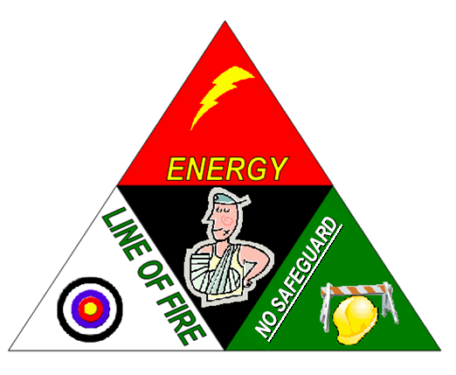
Model #1
Release of / Source of Energy
In the Line of Fire
Inadequate or no Safeguards (barriers)
A combination of …
Energy (controlled or uncontrolled release or protected / unprotected source), and
Line-of-Fire (intentional or not intentional), and
Lack of Safeguard
… will result in an injury incident.
Chapter 2.2 Anatomy of an Incident
6
Notes:
6

Slide 7
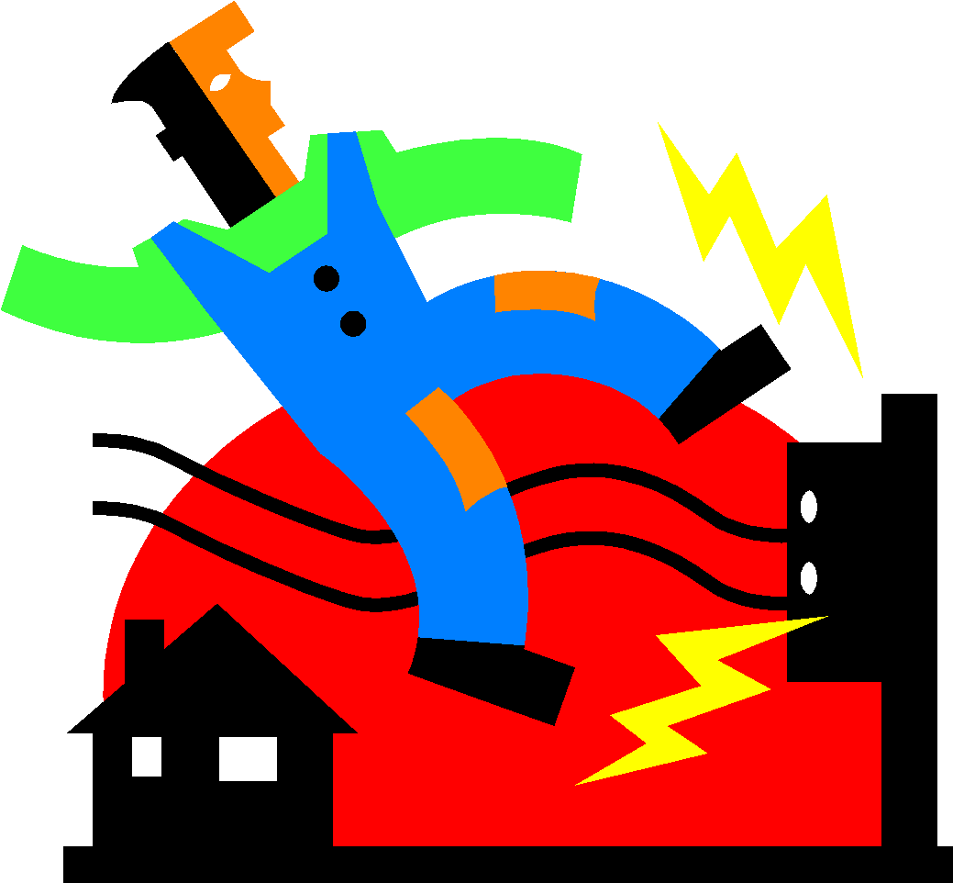
Model #2
Release of / Source of Energy
In the Line of Fire
Triggers or Triggering Event
A combination of …
Energy (controlled or uncontrolled release or protected / unprotected source), and
Line-of-Fire (intentional or not intentional), and
Triggers
… will result in an injury incident.
Chapter 2.2 Anatomy of an Incident
7
Notes:
7

Slide 8
Applications of the Two Models:
Can be applied to analyze a loss incident …
Can be applied to analyze a set of conditions or circumstances that may lead to a loss incident …
Regardless of which model is used or applied, if all three components happen at the same time, there will be a loss incident.
Lack of Safeguard
Trigger
Chapter 2.2 Anatomy of an Incident
8
Notes:
8

Slide 9
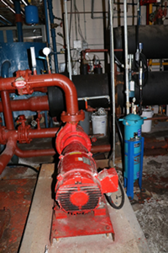
Ammonia Leak At Fernie Memorial Arena:
Date of incident: Oct 17, 2017
Ammonia leak in Fernie rink
Ammonia monitoring & alarm system in place
Upset condition & workers responded to alarms
Lack of practice for emergency procedures
Three worker deaths
Refrigeration Equipment:
~ 30 years old at time of incident
Life span: 20-25 years
Oct 5, 2010 – recommendation to replace equipment
Jan 4, 2011 – another recommendation to replace eqpt
Refrigeration process passes tubes full of hot & cold brine through a pipe filled with ammonia. The tube full of hot brine turns the ammonia into gas in one part of the pipe, cooling the brine in another - creating ice in the process.
Critical to keep brine & ammonia from mixing.
Module 2-02: Anatomy of an Incident
9
Notes:
9

Slide 10
Ammonia Leak At Fernie: A Deeper Dive Into The Incident
Activity/Process: Refrigeration process uses ammonia and brine to make ice surfaces for skating, hockey, and curling
Hazard: Ammonia contained in piping (highly toxic, reactive, corrosive)
Consequence: corrosion of brine loop piping materials (ammonia leaked into brine piping & a connection subsequently failed under pressure)
Impact on PEAP: three fatalities (P), leak of toxic material (E), ? (A), rinks out of use for a period of time, schedule disruption (P)
Module 2-02: Anatomy of an Incident
10
Notes:
10

Slide 11
Ammonia Leak At Fernie: A Deeper Dive Into The Incident
Type of incident: “Occupational Safety” or “Process Safety”? Both!
OS: Failure to wear PPE, respiratory protection, breathing apparatus
PS: Failure to prevent corrosion of the piping system
Which model works best: “#1 Lack of Safeguard” or “#2 Trigger”?
#1 Lack of Safeguard: Workers responded to leak without necessary breathing apparatus
#2 Trigger: Loss of “control” (containment) of ammonia caused by non-detected corrosion of the piping system
If you were in charge of Alberta OH&S, what would you do in response to reading the WorkSafeBC Report?
November 2017: WorkSafe BC kicked off a 3 phase review
Phase I – 180 of 223 rinks in BC use ammonia
Phase II – review of contractors who work on ammonia systems
Phase III – review other BC industries that use ammonia (food processing, industrial chemical manufacturing)
Module 2-02: Anatomy of an Incident
11
Notes:
11

Slide 12
Summary
All activities have associated hazards; uncontrolled hazards lead to consequences.
Understanding and analyzing the why & how of incidents are important for learning to prevent loss incidents.
The best organizations learn from both their incidents & those of others.
Occupational and process safety are related & both are important.
Two models for Incidents:
Source of energy and
Being in the line of fire, and
Lack of safeguards or a trigger mechanism
Chapter 2.2 What is Risk?
12
Notes:
12

